Slide 1
Hackathon Project Final Presentation
March 27th, 2022
Carpe Datum
Irvin Shen, Roberto Dailey, Santosh Balachandra, Rachel Welch
Mechanical Engineering, Operations Research (PHD), Electrical Engineering, Petroleum Engineering

Slide 2
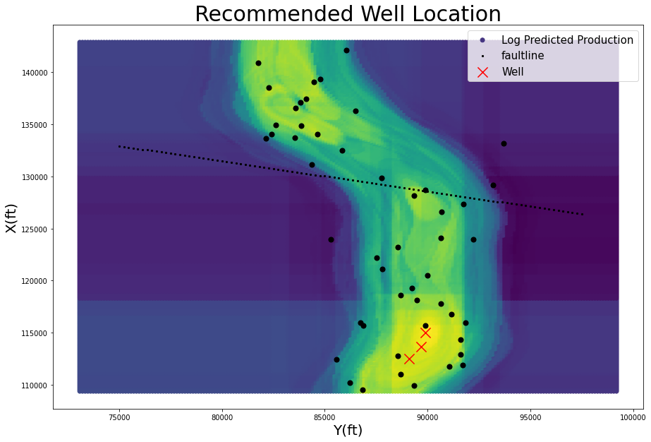
Executive Summary
Problem Statement
Given data of 50 oil wells pumping from a channel, predict the optimal location for 3 new wells and forecast their 2-year production
Our Recommended Solution

Slide 3
Addressing the Problem
Standard 3-step approach
Things we learned
Petroleum engineering fundamentals
Sparse machine learning
Scoping out difficult, vague problems
Exploratory Analysis
Data Processing
Modeling

Slide 4
Workflow
There was a lot of data, so step 1 is visualization to better understand it.
The data is sparse; however, acoustic impedance is dense. This is a good starting point for visualization
Since channel data is 2D spatial and well position is 2D spatial, it makes sense to visualize these datapoints together
Visualization on next slide

Slide 5
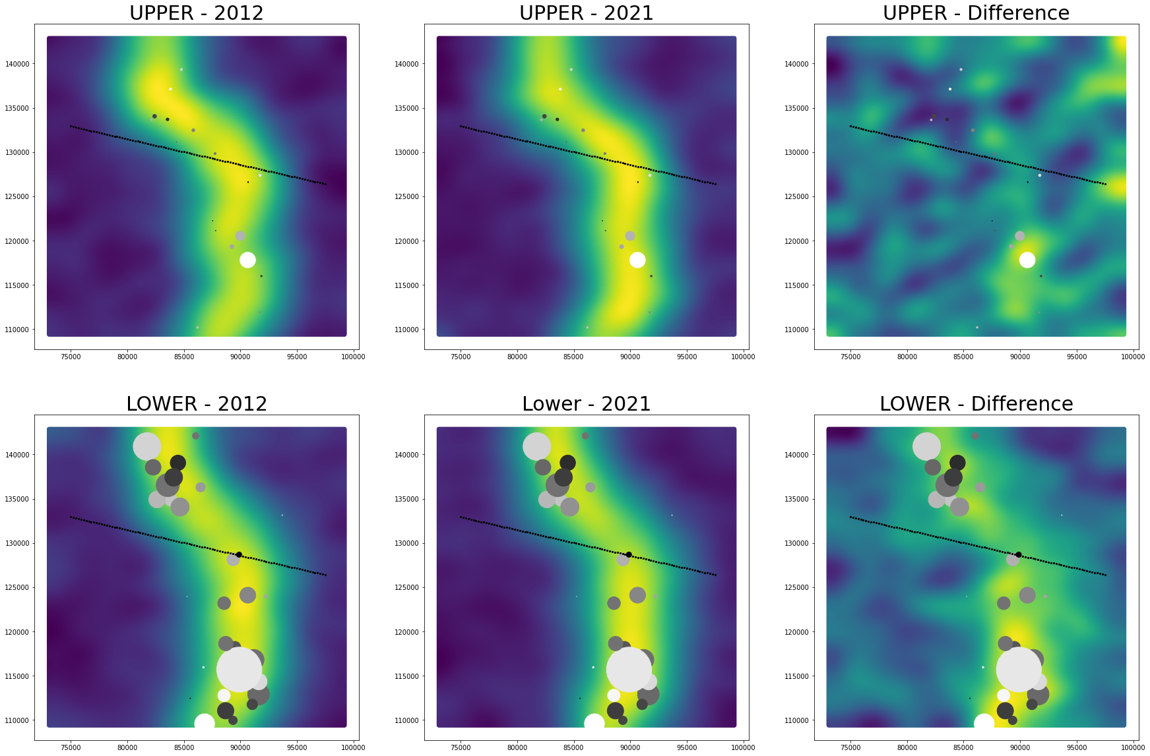

Slide 6
Visualization
A few key observations
Lower wells have significantly higher cumulative production than upper wells
Successful wells are placed in areas with high acoustic impedance (AI)
Wells increase their AI over time because pumps replace low-density oil with high-density water and AI = (density)(velocity)

Slide 7
Visualization
Our guiding intuition
Use the rich spatial acoustic impedance information to interpolate the well features across the entire space

Slide 8
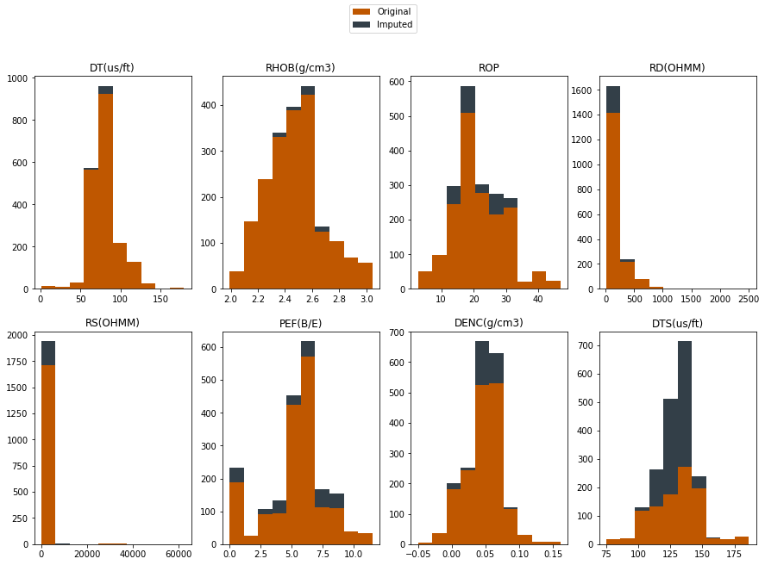
Data Processing
Main goal of data processing is to convert an entire well (a csv) into a single datapoint. We find that it is suffice to average over the Z-axis features for each well.
How do we address missing values? We use KNN and Polynomial Regression for context-aware feature imputation.

Slide 9
Modeling
Modeling happens in two parts: interpolation and machine learning.
Interpolation: extend the feature set for each well over the entire space of the dataset
Machine Learning: use to predict two-year consumption

Slide 10
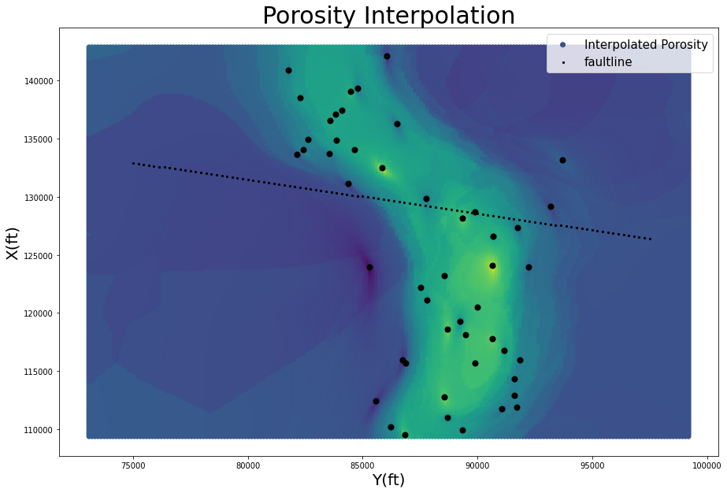
Interpolation
Example: porosity is only recorded at the sparse well locations. We use Linear KNN interpolation to generate porosity at each point in the dataset. Can extend this towards any well feature.

Slide 11
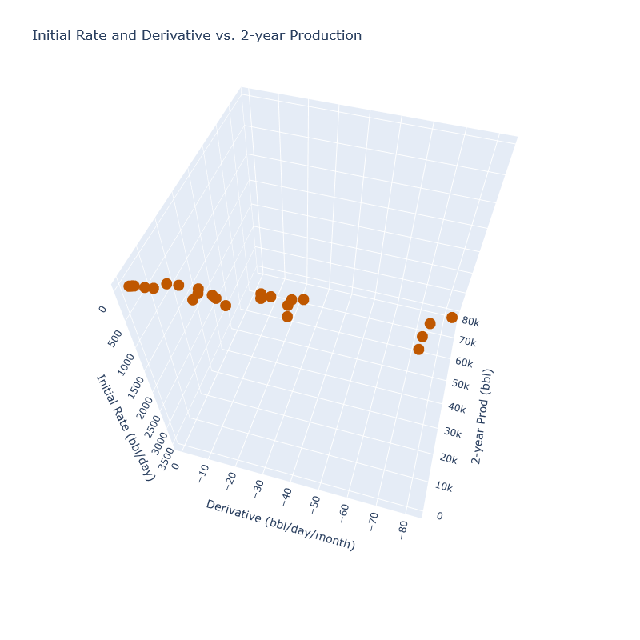
Modeling
Use machine learning to predict cumulative 2-year production over the entire interpolated feature space.
How to get cumulative 2-year production? We use regression to model the decline curve of each existing well. We predict 2-year production based on initial flow rate and the derivative of initial flow.
R^2=.99

Slide 12
Modeling
Once we have cumulative production and features at each well, we have a machine learning problem. Predict cumulative production as a function of well features + acoustic impedance.
Validation
How to know if a model is performing well? We leave one well out and use the other wells + interpolation to predict the cumulative production of the left-out well. Repeat for all 50 wells.

Slide 13
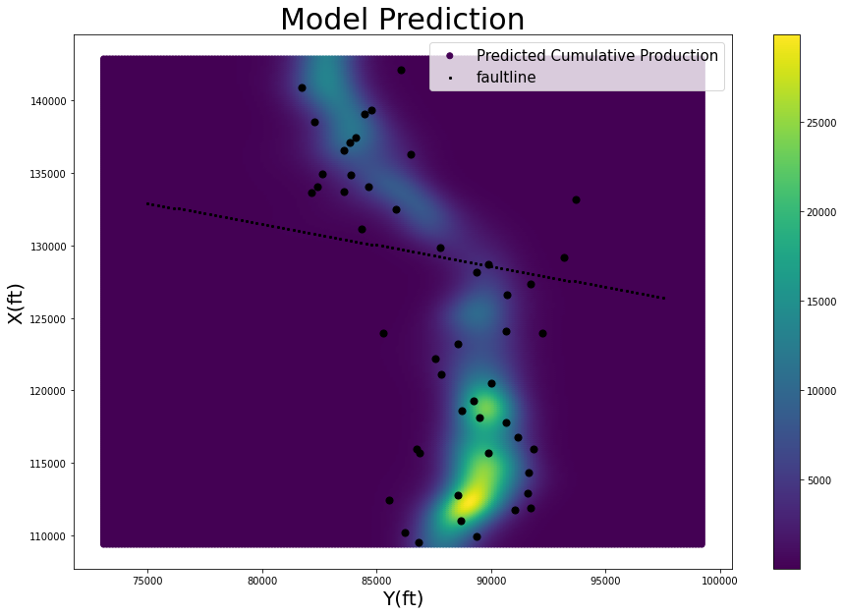
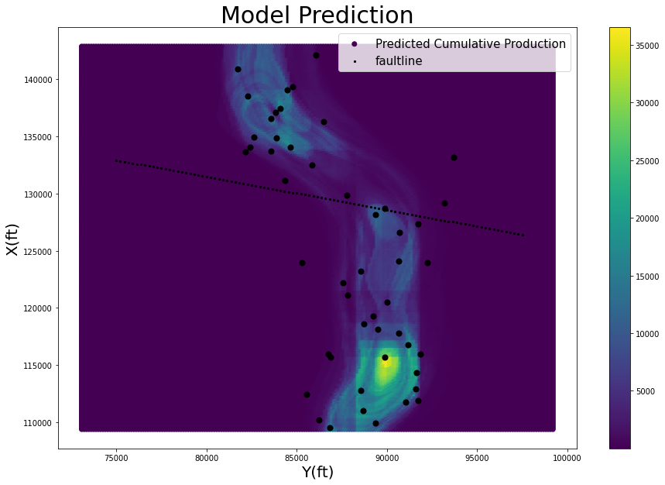
Modeling
Our final model consists of 2 viable models: a high-variance model with better performance, and a low-variance model which better captures the underlying trend.
Linear Model
Random Forest

Slide 14
Modeling
Based on this production chart, we manually select well locations, accounting for interaction effects by placing away from existing wells.
Linear Model
Random Forest

Slide 15
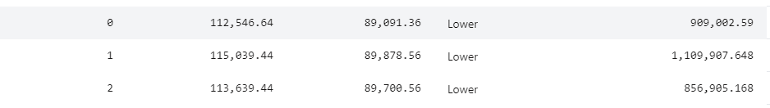
Final Prediction
Based on this production chart, we manually select well locations, accounting for interaction effects by placing away from existing wells.

Slide 16
Feedback
What did your team learn?
This was a unique problem new to all of us, so we learned how to manipulate
We appreciated tips and assistance from all of the mentors.

